Slide 1
BUILDING THE INFRASTRUCTURE FOR INTERNATIONAL TRAINING
Tom Wylie
Custom Training Solutions
a division of
Northwest State Community College
Archbold, Ohio
Notes:
Just testing out the note stuff.

Slide 2
Presenters’ Contact Information
Tom Wylie – VP of Workforce Development 419.530.3309 twylie@northweststate.edu

Slide 3
An Overview of our Presentation
The need for Incumbent Worker Training.
Types of training companies need.
Adaptive Learners are in high demand.
Various methods of delivering training to Corporations.
Materials/Curriculum Development.

Slide 4
Incumbent Worker Training
Incumbent workers are currently working in positions within Business & Industry.
Our traditional college educates the emerging, displaced and the underemployed workforce.
Custom Training Solutions focuses on the Incumbent workers, using multiple methods of instructional delivery.

Slide 5
Incumbent Workers Cont.
A major reason for the need to train Incumbent workers is the “Technology Half Life”.
“Technology Half Life” is defined as the amount of time that it takes for ½ of what you learn in college to become obsolete.
One major food processor requires that 4% of every employees job is in the training room.

Slide 6
Custom Training Solutions
CTS Focus---To improve the competitiveness of our clients through training & related services that will improve human performance.
Separate website from NSCC, since we compete with private training firms. www.trainwithCTS.com
Last year CTS trained over 5000 employees at 175 companies within the US and beyond.
CTS pushes a private sector look and brand, in order to compete with private training firms.

Slide 7
CTS Extends Beyond NW Ohio
Currently deliver training in 32 states within the US. As well as Canada, Mexico and approximately 20 countries off the NA continent.
Our largest client is General Mills, world wide. Approximately 100 food plants.
CTS delivers Plastics training to the Mid American Plastic Processor (MAPP), made up of over 220 plastic companies in the US.

Slide 8
Training Services Offered to Industry
Computer Training –basic to advanced. Crystal Reports, Visio, MS Project, etc.
Management/Leadership – Communication Skills, Front Line Supervision, etc.
Language (Conversational, Travel, Technical).
Technical/Automation – See Listing.
Multiple ways to deliver training with Technology.
Development of /Knowledge Management.
eMeetings (reduce & eliminate travel)

Slide 9
Technical Training NSCC Delivers
CAM (GibbsCAM & MasterCAM)
Plastics (Materials, Injection, Extrusion, Blow Molding)
Basic Electrical (including VFD Drives)
Allen Bradley PLCs(5, 500, 5000, Compact)
Siemens and Mitsubishi PLCs
Instrumentation & Controls (CCST)
ControlLogix PLCs/ControlNet
Wonderware, Devicenet, Ethernet/IP
Pneumatics/Hydraulics, Robotics & Servos
Machining, CAD, Quality/SPC.
Welding, Print Reading, GD&T

Slide 10
Partial CTS Client List
Campbell Soup
General Mills
Sauder Woodworking
Chrysler
Ford
General Motors
Honda
Longaberger
Smuckers
Owens Illinois
Plastech
Northstar Bluescope
Jeep/Kuka/Magna
First Energy
Libbey Glass
TRW
Johns Manville
Rolls Royce

Slide 11
Employers want Adaptive Learners
These are employees that can learn different ways, not just with traditional classroom instruction.
Video Conferencing Training (Synchronous)
Web Conferencing Training (Synchronous)
Online Web Courses (Asynchronous)
Web research (manufacturers literature)
All General Mills employees are required to take web courses. (An important trend)

Slide 12
CTS Delivers Training Four Different Ways
Traditional Instructor Led Training (on-site with portable equipment – we travel)
Video Conferencing Training
Web Conferencing Training
Web Courses (Technical)

Slide 14
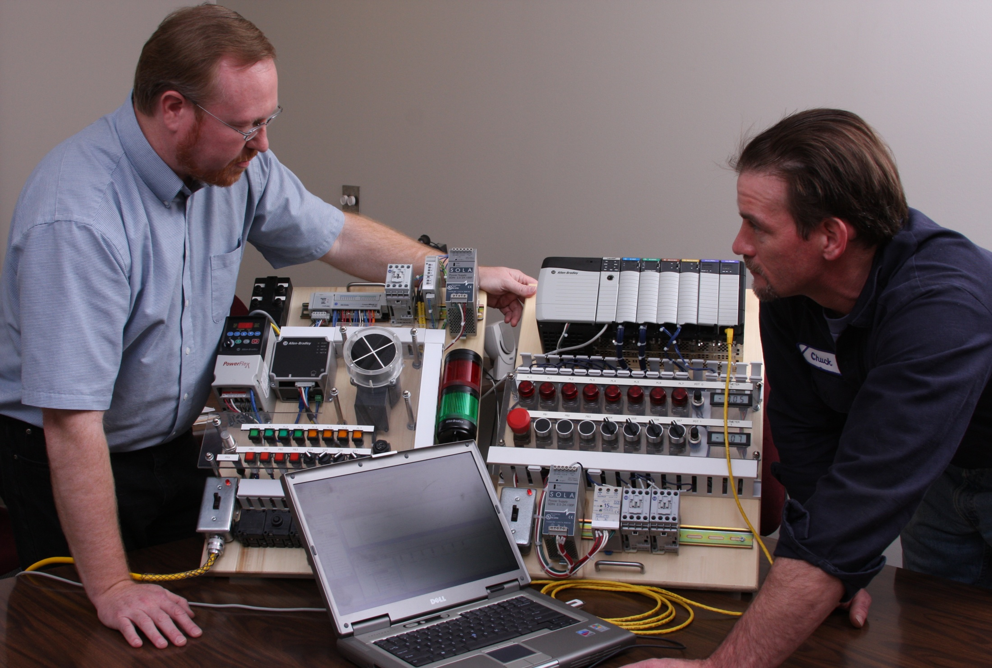

Slide 15
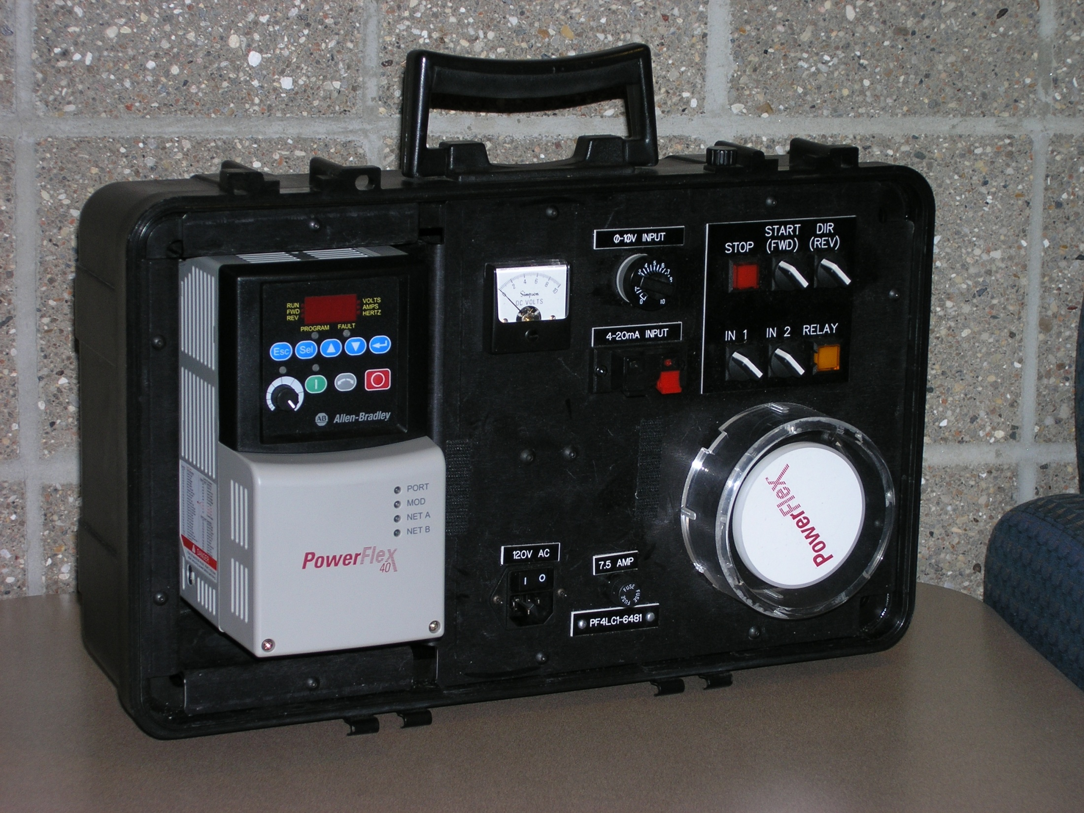

Slide 16
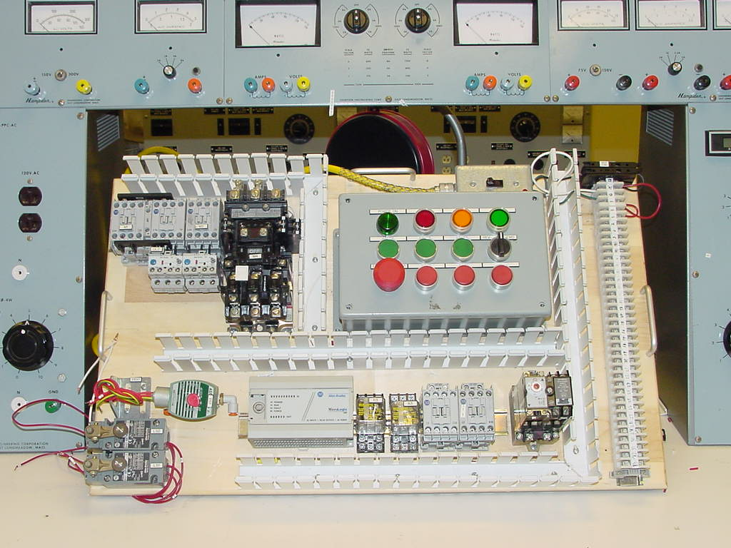

Slide 17
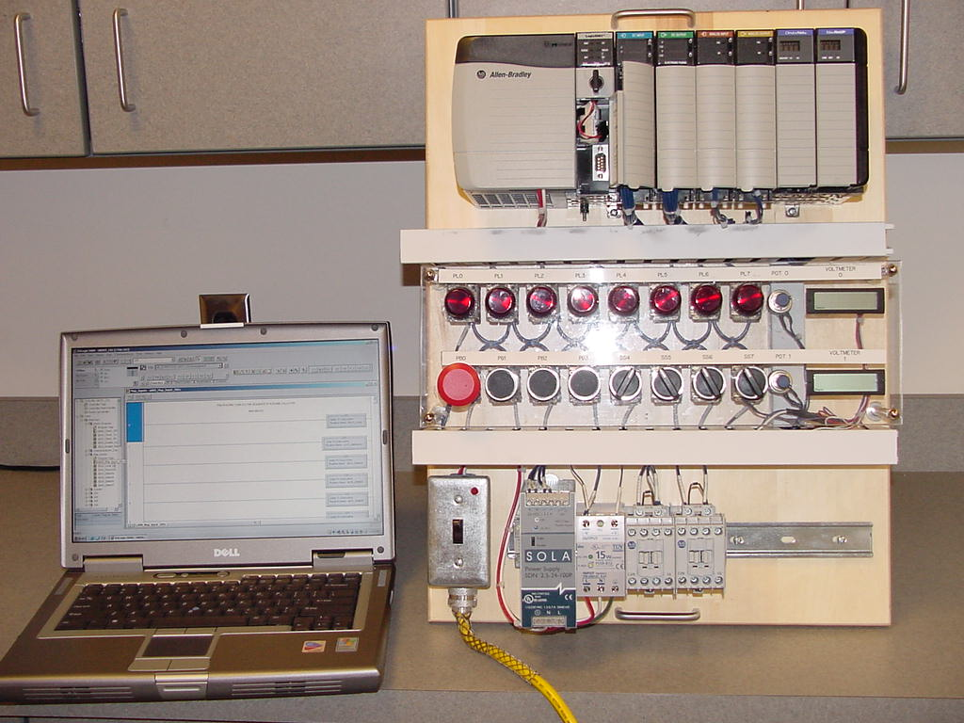

Slide 18
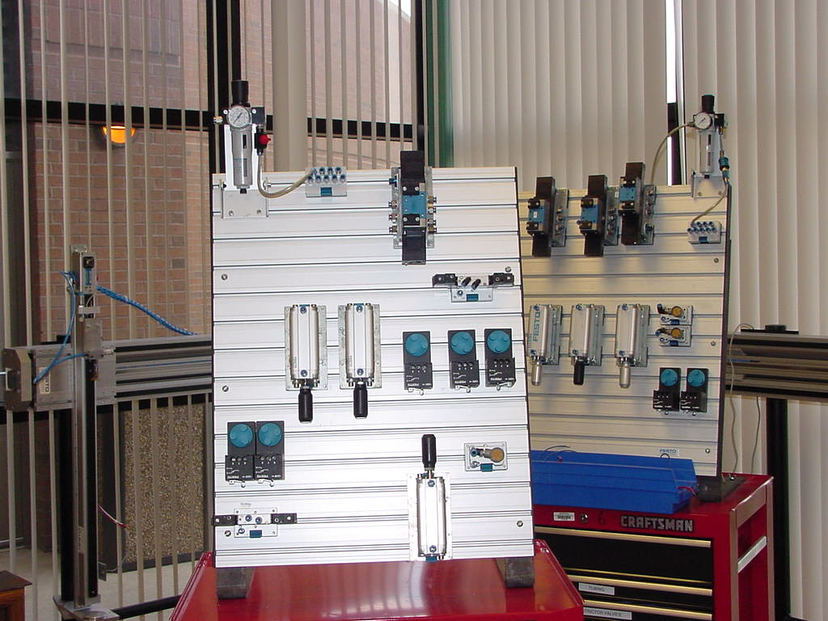

Slide 19
eLearning Terminology
Web courses are asynchronous—they can be taken anytime for the convenience of the trainee.
VC and Web Conferencing are synchronous—classes are scheduled. There is full interaction between the instructor and trainee.

Slide 20
Live Virtual Classrooms
Multiple Sites connected together.
Students can see and hear each other from any sites around the world.
Students view instructional material from the instructor computer screen.

Slide 21
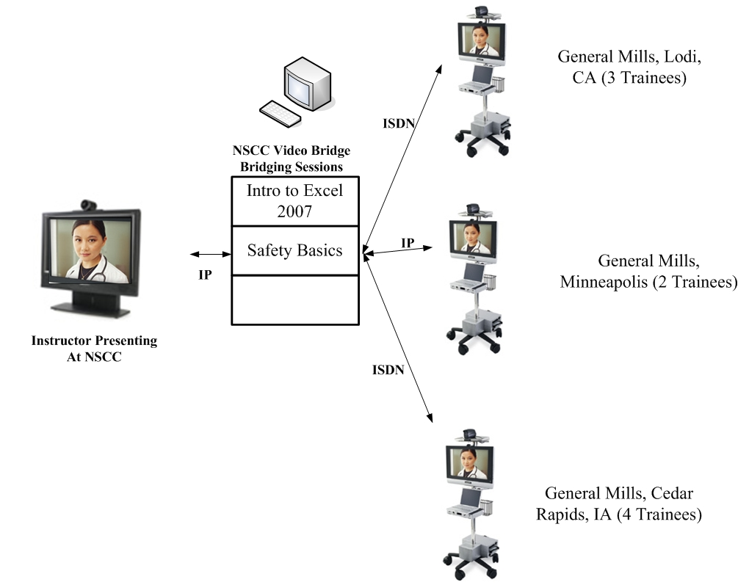

Slide 22
WEB Conferencing Training
Video is not used. Audio and computer sharing is required.
SMARTboard technology is with a bridging system and an internet connection.
Students will see the instructor’s computer screen and the instructor can view the students’ computer screens.
Good training materials must be developed in order to be effective.

Slide 24
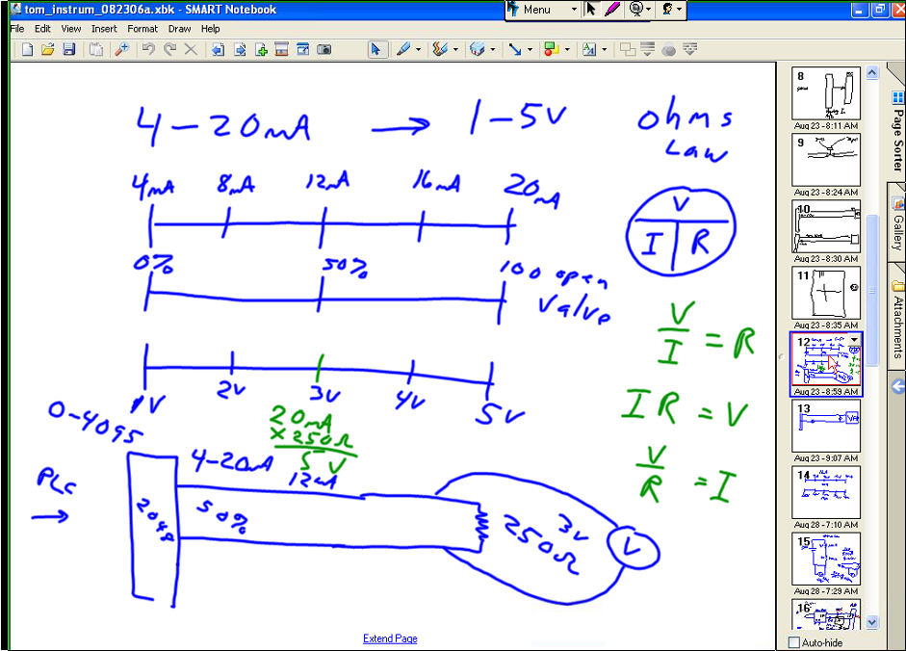

Slide 27
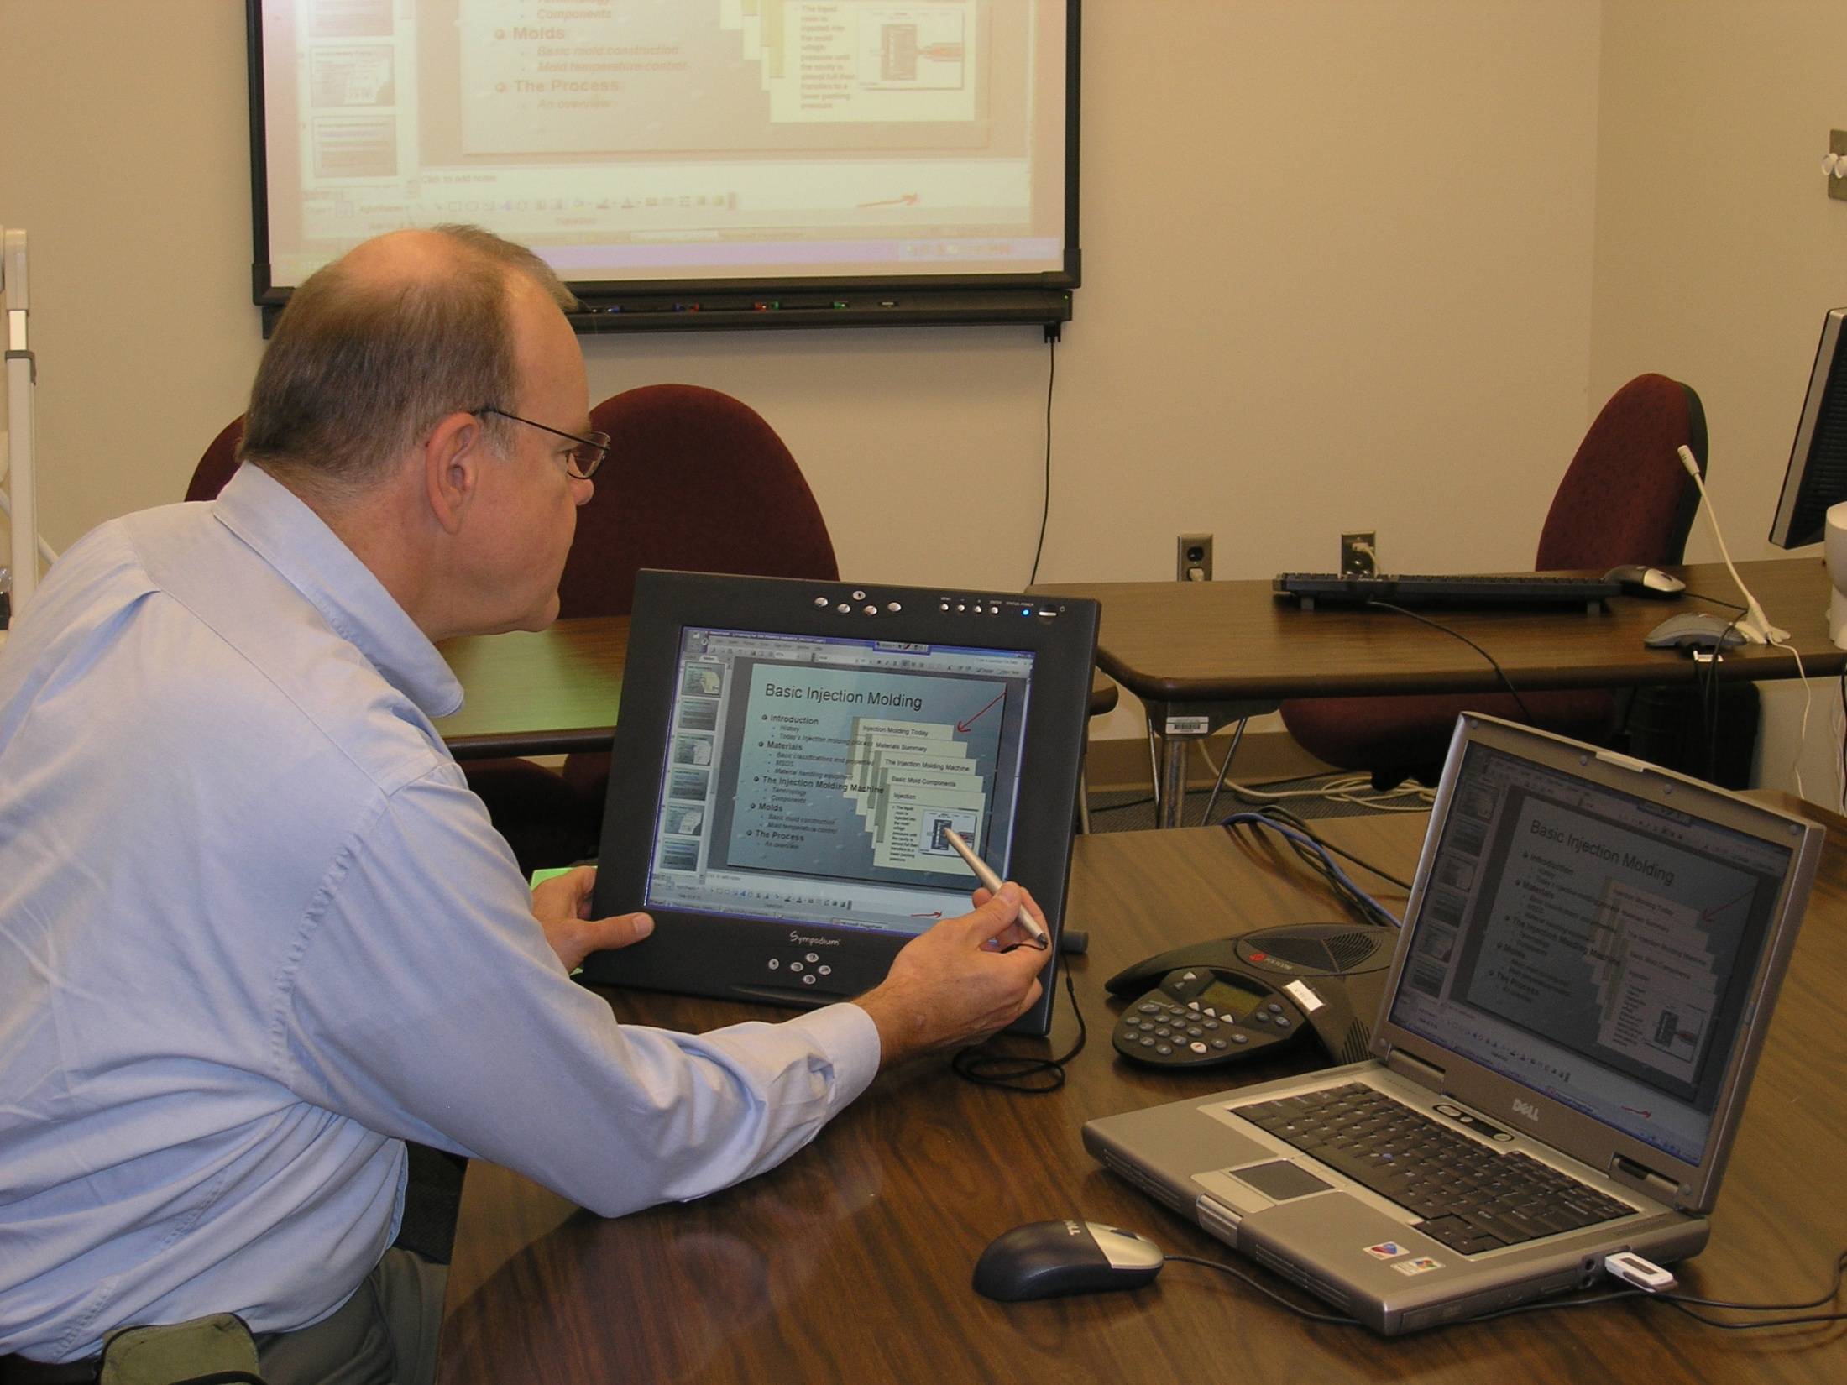

Slide 28
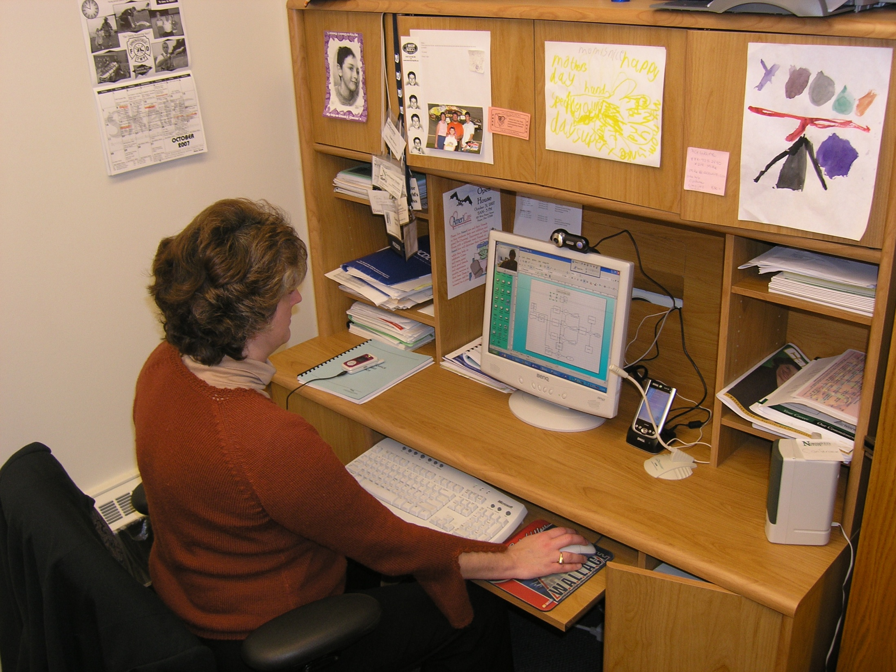

Slide 29
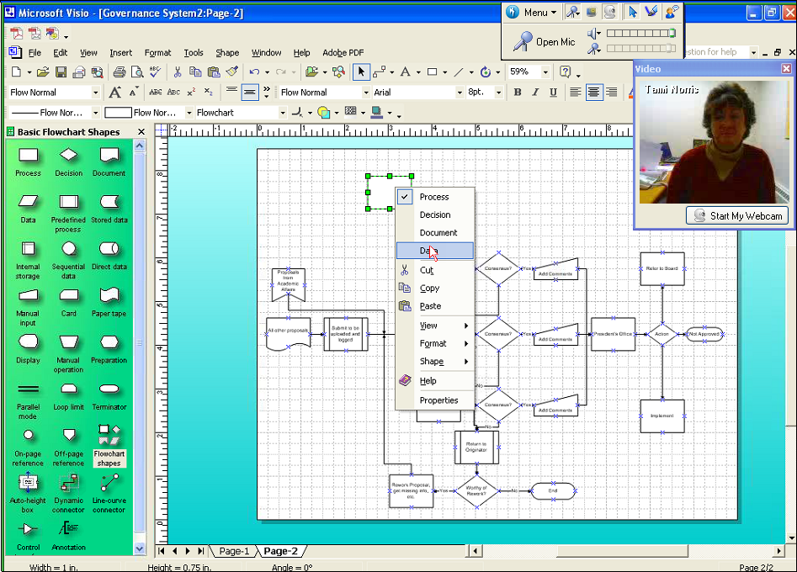

Slide 30
Training Materials
Text books are not used for the training.
DACUM process is used to create curriculum.
CTS develops student manuals, instructor guides, labs, simulations and job aids.
Instructors must do development, and work with a course designer.
Pre/Post Assessments are required.

Slide 31
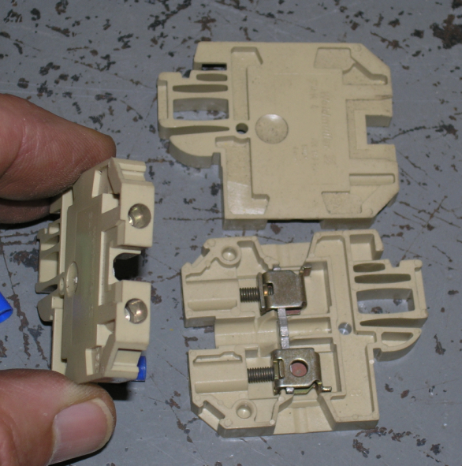
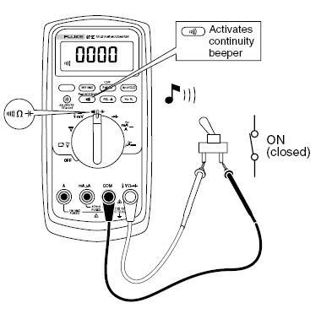
CONDUCTOR TERMINATION BLOCK
CUSTOM LEARNING AIDS
ZERO RESISTANCE WITH OHM METER
Ω

Slide 32
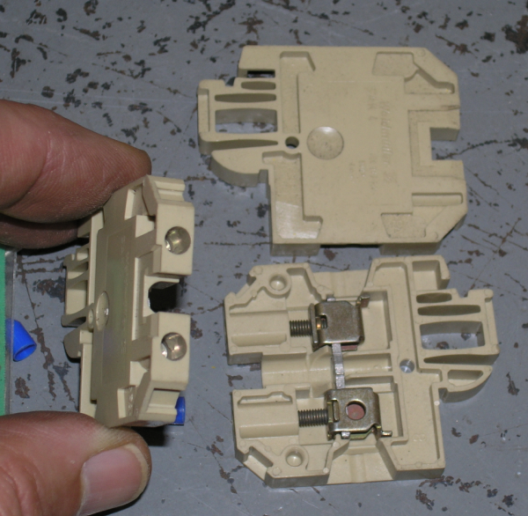
CUSTOM LEARNING AIDS
VERY LOW RESISTANCE
CONTINUITY BETWEEN TERMINATION SCREWS
Ω

Slide 33
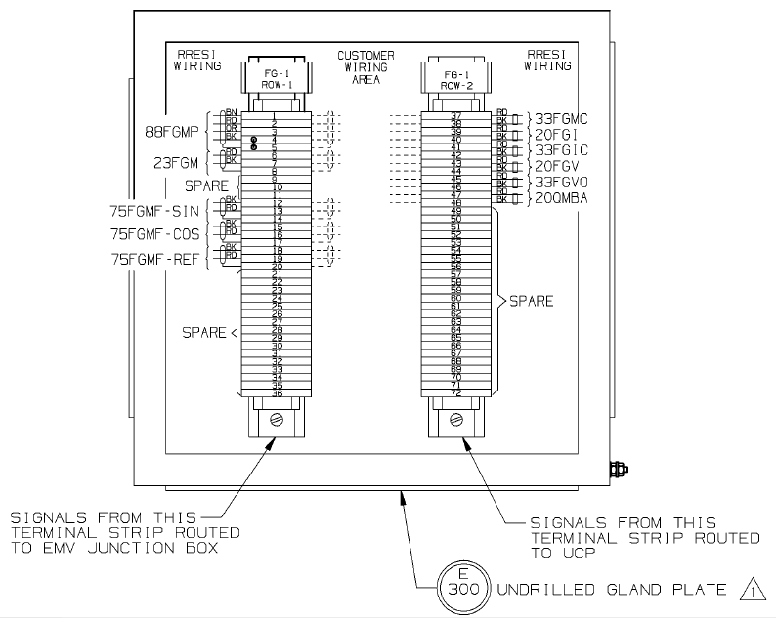
CONDUCTOR TERMINATION BLOCK
CUSTOM LEARNING AIDS
TERMINAL BLOCKS WILL SNAP ONTO JUNCTION BOX RAILS

Slide 34
PLC INPUT ACTION
CUSTOM LEARNING AIDS
L1
N
INPUT
CPU
120 vac
COM
1
S-1
1
1
120 vac
2
POWER SUPPLY
3

Slide 35
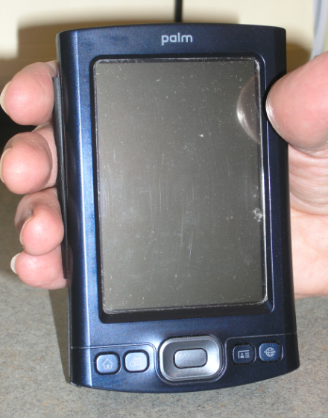
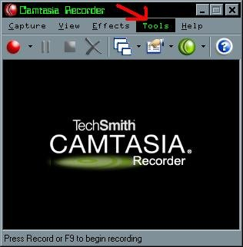
CUSTOM LEARNING AIDS

Slide 36
Questions???

